Slide 1

Hebrew NLP Pipline
NLP@BGU
Dr.Raphael Cohen,
Data Science Services,
EMC

Slide 2
The Stack - Needs
Tokenization – separating words (is . end of line?)
Morphological Analysis:
Segmentation
POS Tagging
Morphology
Syntax – Constituency / Dependency Parsing
Semantics – FrameNet
Topic Modeling

Slide 3
Tokenizaiton
Separate various punctuation
Identify end of sentence
Medical: may be hard. e.g. “M.R.I.”
Separate foreign and hebrew words
חשד לCA OF PANCREAS בסי טי מהקופה

Slide 4
Morphological Analysis
Meni Adler et al.

Slide 5
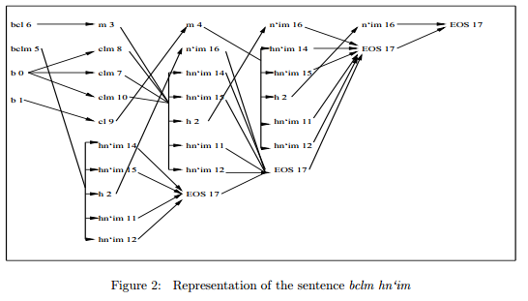
Morphological Analysis
Meni Adler and Michael Elhadad (2006)
Hebrew has complex rules of word formation
Agglutinative: prefixes and suffixes (~150)
High ambiguity (2.4 possible senses in Hebrew compared to 1.4 in English)
Adler and Elhadad combine segmentation and morpheme tagging using an HMM model over a lattice of possible segmentations

Slide 6
Morphological Analysis – cont’
Meni Adler and Michael Elhadad (2006)
Method uses a lexicon to find all possible seg-mentations for all tokens
Unknown words are segmented using all possible segmentation and choosing based on context
Segmentation accuracy is 98%
POS + Segmentation accuracy is 94%

Slide 7
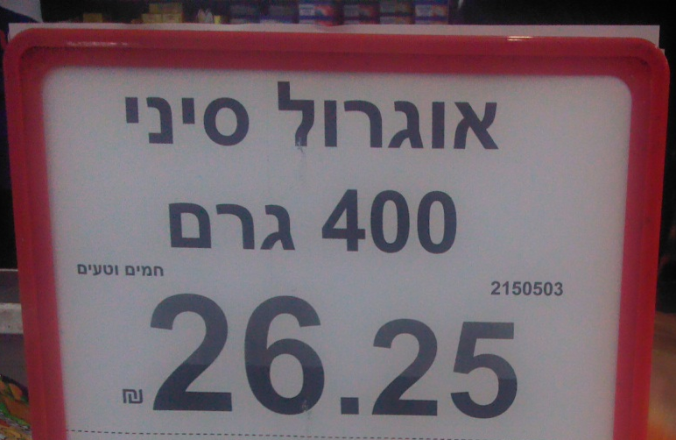
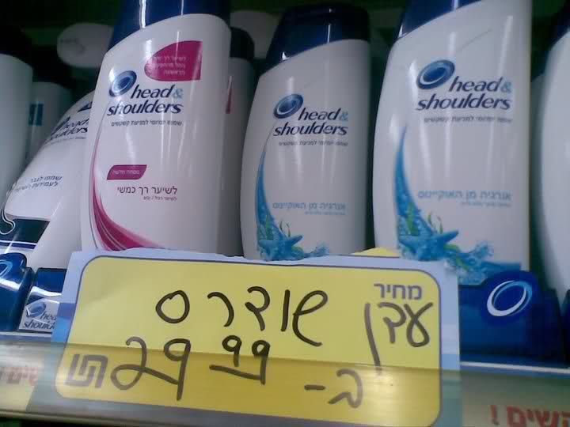
Segmentation in Medical Hebrew
Raphael Cohen and Michael Elhadad (2013)
Segmentation accuracy drops on transliterations
Not by much- but these are medical terms

Slide 8
Error Analysis – Transliterations
Unknown tokens make up most of the errors.
Most unknowns are medical words borrowed from English / Latin (“Stent”-> “סטנט")

Slide 9
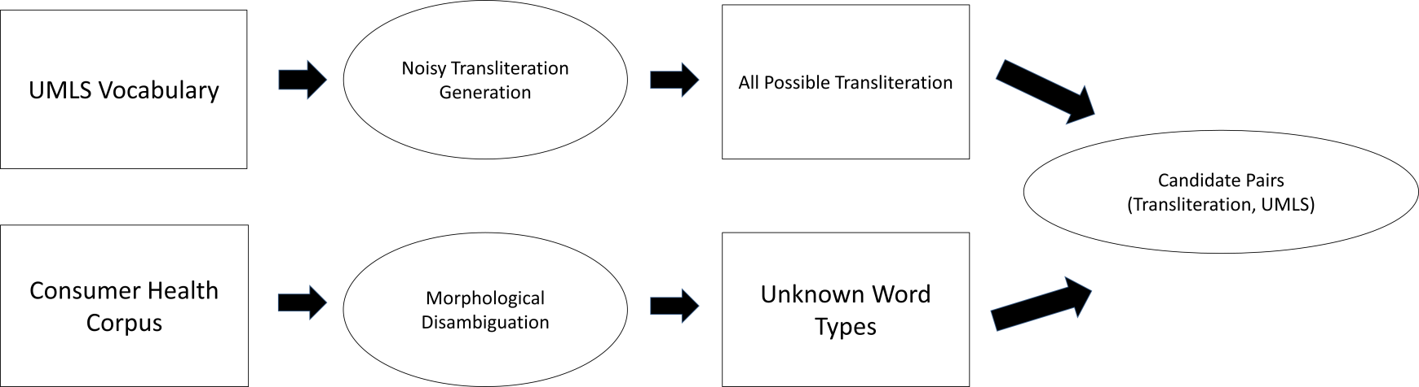
Acquiring a transliteration dictionary
Data Driven Acquisition
Noisy Transliterate
Corticosteroid → קורטיקושתראיד , קורטיקוסטירעויד, קורטיקוסטירעוייד, קורטיקוסטירעואיד, קורטיקוסטירואיד… (41K possibilities).

Slide 10
Result – Hebrew-UMLS dictionary + Hebrew-Medical-Lexicon
~3,500 Hebrew-UMLS terms acquired automatically
Combined with hand-crafted dictionaries collected from the WWW
Final dictionary: 8,500 Hebrew-UMLS terms, verified manually (web resource had 91% accuracy compared to 78% for automatically acquired resource).
Lexicon with linguistic knowledge for the unknown terms.
Error reduction of 50% on segmentation

Slide 11
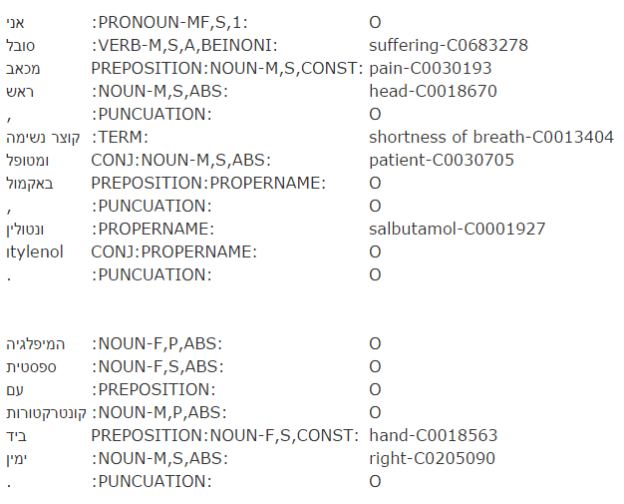
Entity Linking
Connect to UMLS terms
http://www.cs.bgu .ac.il/~cohenrap/ entitylinking.html

Slide 12
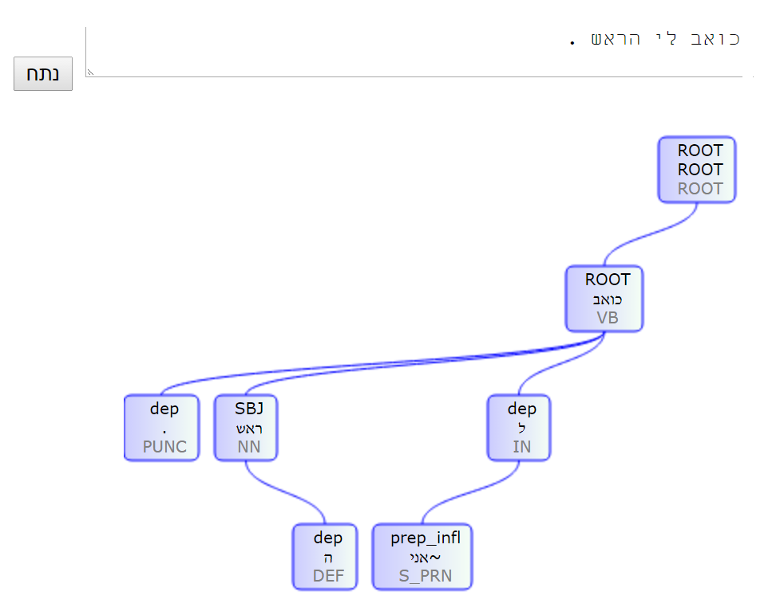
Syntax – Dependency Parsing
Yoav Goldberg and Michael Elhadad
Relationship structure between words
Useful for:
Negation detection
Named Entity Recognition
Information extraction

Slide 13
Syntax – Medical Domain
NLP @ BGU Lab (Yael Netzer, Inga Isakov)
A small tree bank has been constructed
Some domain adaptation is still recommended:
Co-training (Sagae): training 2 parsers, tagging new data and using high agreement trees to expand treebank
Syntactic clusters, additional features:
Source | Semantic Class | Arguments | Predicates
Genia | Cell-cycle process | stages stage process steps committed block regulator acquire switch points needed directs determinant il-21 proceeds arrest regulators relate d3 | differentiation development activation maturation cycle hematopoiesis infection commitment lymphopoiesis stage lineage selection erythropoiesis cascade
Genia | Cells and growing conditions | supernatants co-culture co-cultured replication medium surface chemotaxis supernatant beta | cell monocyte lymphocyte pbmc macrophage line blood neutrophil cd dc leukocyte t eosinophil fibroblast

Slide 14
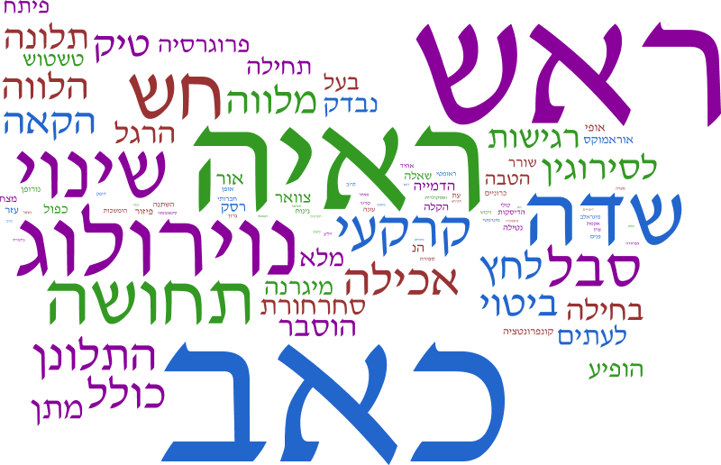
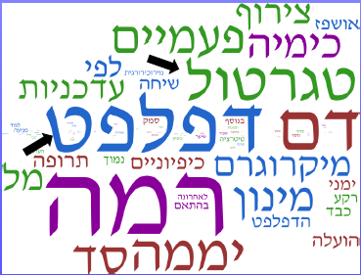
Topic Modeling (LDA)
BGU @ NLP
We recommend MALLET
Use lemmas from Morphological Analysis
Remove redundancy!

Slide 15
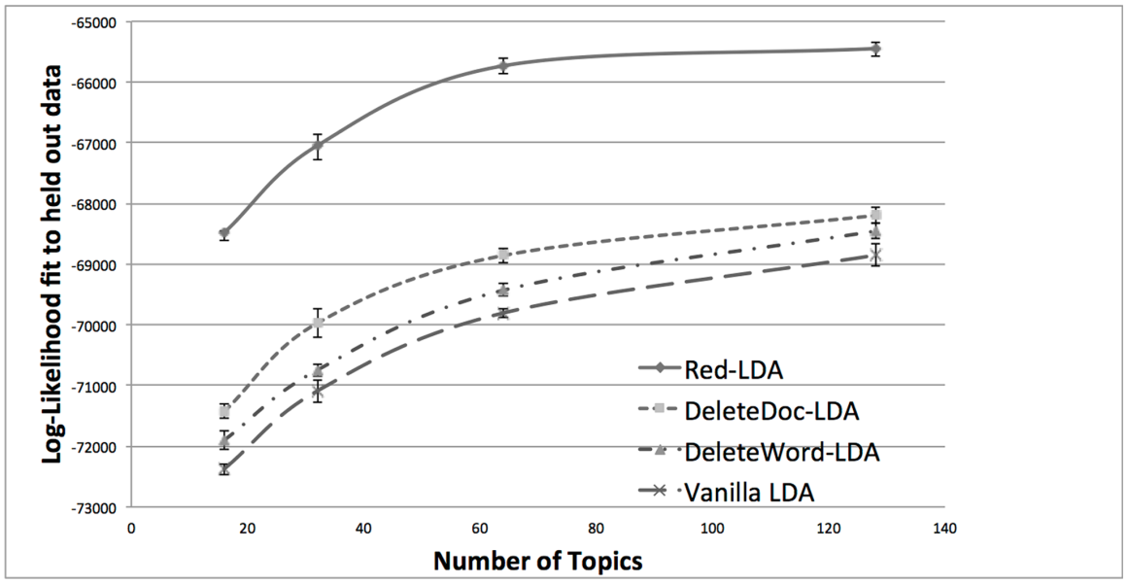
Topic Modeling on Noted
Redundancy
Same patient notes contain a lot of copy-paste material
This is detrimental to count based ML algorithms
Also, be careful dividing train/test

Slide 16
Where do we go from here?
???
Some missing stuff:
Normalization (spelling correction and the like)
Awesome annotating environment
Wrapping the Analyzer in Hadoop or other distributed API
Medical FrameNet
Great discoveries with NLP

